Slide 1
Heart Disease Prediction using Graph Neural Networks
Ahlam Almuqhim
Shirin Amiraslani

Slide 2
Introduction
Cardiovascular diseases A leading global cause of death, responsible for millions of lives lost each year (WHO).
Early detection is critical, but traditional methods are resource-intensive and inaccessible.
Objective:
Explore AI-based methods, specifically Graph Neural Networks (GNN), to improve heart disease prediction.

Slide 3
Dataset Overview
UCI Heart Disease Dataset:
Features include age, cholesterol levels, maximum heart rate, chest pain type, and more.
Goal: Classify patients into five severity levels (0-4), where 0 indicates no heart disease, and 4 represents the most severe condition.
Previous Work: Traditional ML models (Random Forests, SVMs, etc.) used for prediction.
Final model: neural network with 3141 parameters

Slide 4
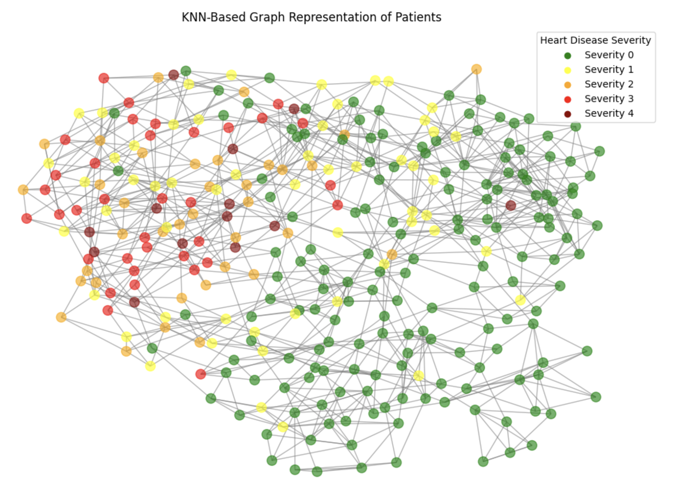
Methodology
Graph Representation:
Patients as nodes, with clinical features as node attributes.
Edges based on similarity between patient features.
Masks added; prevent the model from accessing the target label.
Edge Construction (using KNN):
Normalization of features
K-Nearest Neighbors (KNN) used to find patients with similar clinical profiles based on Euclidean distance. K=5
Graph Neural Networks (GNN):
Explored (Graph Convolutional Network) and GAT (Graph Attention Network)

Slide 5
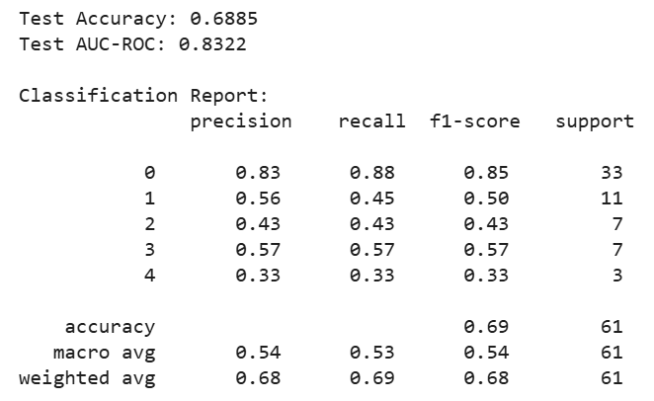
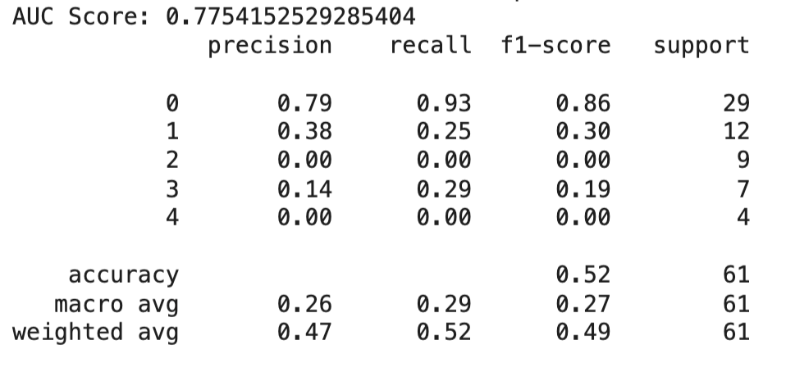
Results from Previous Work
Graph Attention network
➤ Weighted edges ➤ Weighted loss ➤ stratified sampling
➤ # parameters: 515
Simple Neural Network
➤ Stratified sampling
➤ # parameters 3401

Slide 6
Conclusion and Future work
Conclusion Traditional machine learning models provided a baseline, but GNNs may better capture complex patient relationships and provide richer data representations.
Future work will focus on expanding the dataset, exploring dynamic graph construction, and incorporating temporal data to improve predictions. Additionally, experimenting with different K values in the KNN algorithm and filtering relevant features could enhance model performance.

